Slide 1





Big Data Training: Spark
June 2023

Slide 2

Contents
Content | Slide
Introduction to Spark | 03
Architecture | 05
Components of Spark | 08
Applications and Use Cases | 16
Spark SQL | 25
PySpark | 39
Delta Lake (High Level Introduction) | 86
Delta Lake (Practical Demo) | 92
Deloitte Touche Tohmatsu India LLP
J&J | Power BI Playbook

Slide 3

Introduction to Spark

Slide 4

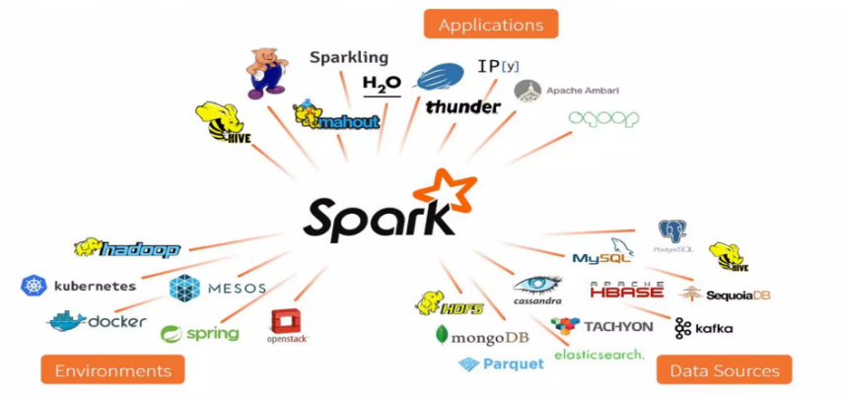
Introduction to Spark
Spark is an open-source distributed computing engine for data processing and data analytics.
Apache Spark
Fast and General Engine for large-scale data processing.
What leads to Spark trending!
Just in Time Data warehouse
Data Realtime, streaming, batch and analytics
Versatile execution engine
Simplified Big Data Processing
Supports wide range of ecosystem and apps
Databricks Spark
Powerful, open-source processing engine built around speed, ease of use and sophisticated analytics.
As your resources mo
-premises t off your costs are administrati decreas
on th
Deloitte Touche Tohmatsu India LLP
Big Data Playbook

Slide 5
Architecture

Slide 6
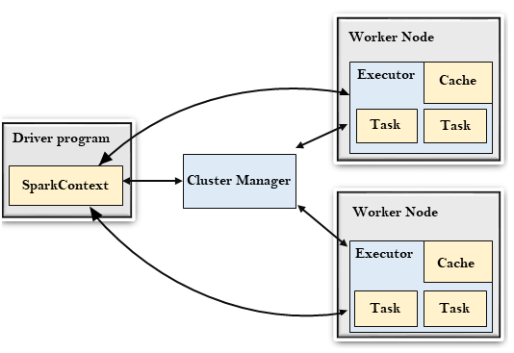
The Spark Architecture
Spark follows the master slave architecture. Its cluster consists of a single master and multiple slaves
Driver Program
The Driver Program is a process that runs the main() function of the application and creates the SparkContext object. The purpose of SparkContext is to coordinate the spark applications, running as independent sets of processes on a cluster.
Cluster Manager
The role of the cluster manager is to allocate resources across applications. The Spark is capable enough of running on many clusters. It consists of various types of cluster managers such as Hadoop YARN, Apache Mesos and Standalone Scheduler.
Executor
An executor is a process launched for an application on a worker node. It runs tasks and keeps data in memory or disk storage across them. It read and write data to the external sources. Every application contains its executor.
Cluster Manager
A unit of work that will be sent to one executor.
Worker Node
The worker node is a slave node. Its role is to run the application code in the cluster.
Deloitte Touche Tohmatsu India LLP
Big Data Playbook

Slide 7




Spark Cluster Managers
By default, applications submitted to the standalone mode cluster will run in FIFO order, and each application will try to use all available nodes.
Apache Mesos is an open-source project to manage computer clusters, and can also run Hadoop Applications
Apache YARN is the cluster resource manager of Hadoop 2. Spark can be run on YARN.
Kubernetes is an open-source system for automating deployment, scaling, and management of containerized applications.
Deloitte Touche Tohmatsu India LLP
Big Data Playbook

Slide 8
Components of Spark

Slide 9
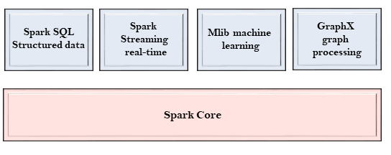
Components of Spark
The Spark project consists of different types of tightly integrated components. At its core, Spark is a computational engine that can schedule, distribute and monitor multiple applications.
Spark Core
The Spark Core is the heart of Spark and performs the core functionality. It holds the components for task scheduling, fault recovery, interacting with storage systems and memory management.
Spark Streaming
Spark Streaming is a Spark component that supports scalable and fault-tolerant processing of streaming data. It uses Spark Core's fast scheduling capability to perform streaming analytics.
GraphX
The GraphX is a library that is used to manipulate graphs and perform graph-parallel computations.
It facilitates to create a directed graph with arbitrary properties attached to each vertex and edge.
Spark SQL
The Spark SQL is built on the top of Spark Core. It provides support for structured data. It allows to query the data via SQL (Structured Query Language) as well as the Apache Hive variant of SQL called the HQL (Hive Query Language).
MLlib
The MLlib is a Machine Learning library that contains various machine learning algorithms. These include correlations and hypothesis testing, classification and regression, clustering, and principal component analysis.
Deloitte Touche Tohmatsu India LLP
Big Data Playbook

Slide 10
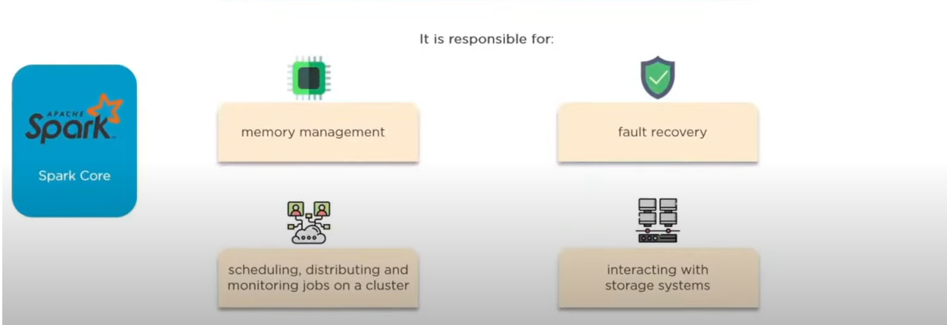
Components of Spark – Spark Core (1/2)
Spark Core is base engine for large scale parallel and distributed data processing
Deloitte Touche Tohmatsu India LLP
Big Data Playbook

Slide 11
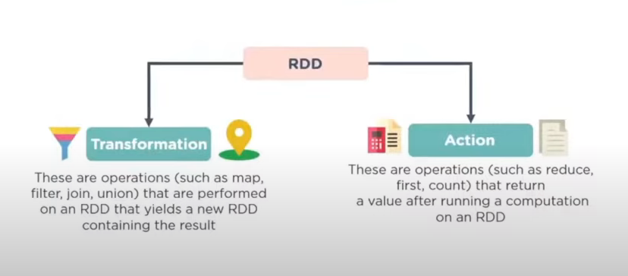
Components of Spark – Spark Core (2/2)
Spark Core is embedded with RDDs (Resilient Distributed Datasets), an immutable fault tolerant, distributed collection of objects that can be operated on in parallel.
Deloitte Touche Tohmatsu India LLP
Big Data Playbook

Slide 12
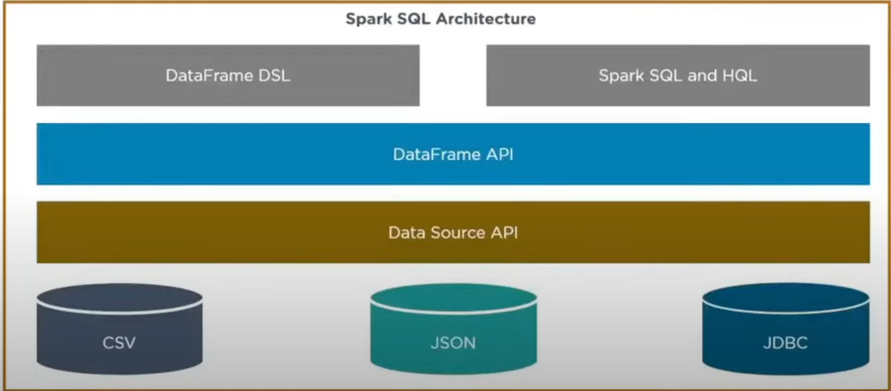
Components of Spark – Spark SQL
Spark SQL Framework Component is used for structured and semi-structured data processing
Deloitte Touche Tohmatsu India LLP
Big Data Playbook

Slide 13
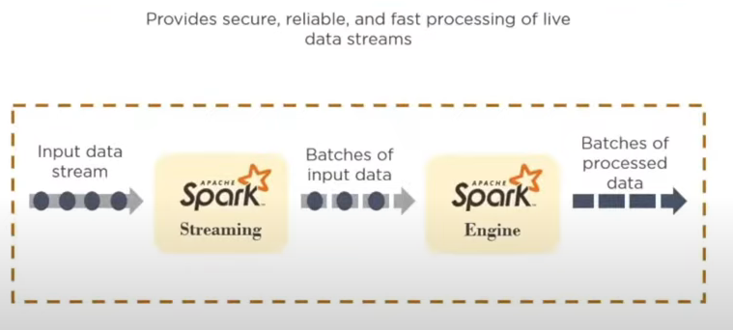
Components of Spark – Spark Streaming
Spark Streaming is a Lightweight API that allows developers to perform batch processing and real-time streaming of data with ease
Deloitte Touche Tohmatsu India LLP
Big Data Playbook

Slide 14
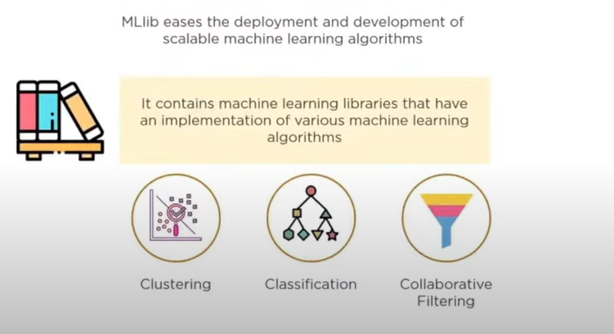
Components of Spark – MLlib
A low-level machine learning library that is simple to use, is scalable, and compatible with various programming languages.
Deloitte Touche Tohmatsu India LLP
Big Data Playbook

Slide 15
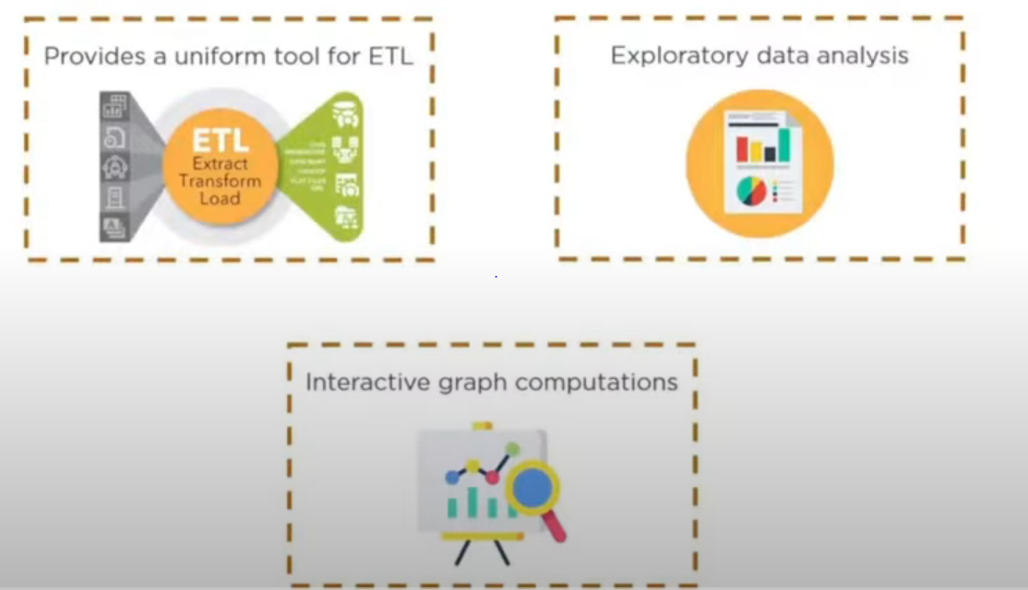
Components of Spark – GraphX
Spark’s own computation engine and data store
Deloitte Touche Tohmatsu India LLP
Big Data Playbook

Slide 16
Applications and Use Cases

Slide 17
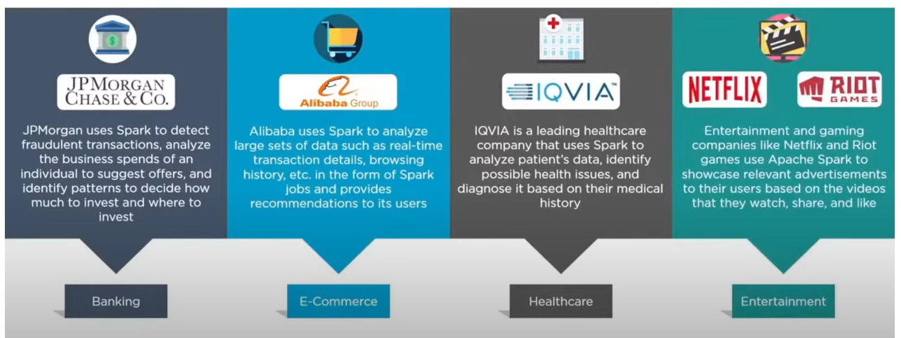
Applications of Spark
Deloitte Touche Tohmatsu India LLP
Big Data Playbook

Slide 18

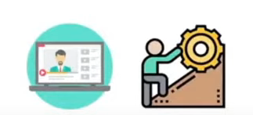

Spark Use Case (1/2)
Conviva is one of the world’s leading video streaming companies
Video Streaming is a challenge, especially with increasing demand for high quality streaming experiences
Conviva collects data about video streaming quality to give their customers visibility into the end-user experience they are delivering
Deloitte Touche Tohmatsu India LLP
Big Data Playbook

Slide 19





Spark Use Case (2/2)
Conviva is one of the world’s leading video streaming companies
Using Apache Spark, Conviva delivers a better quality of service to its customers by removing the screen buffering and learning in detail about the network conditions in real-time
This information is stored in the video player to manager live video traffic coming from 4 billion video feeds every month, to ensure maximum retention
Reduces waiting time before the video starts
Avoids buffering and recovers the video from a technical error
Goal is to maximize the viewer engagement
Using Apache Spark, Conviva has created an auto diagnostics alert
It automatically detects anomalies along the video streaming pipeline and diagnoses the root cause of the issue
Deloitte Touche Tohmatsu India LLP
Big Data Playbook

Slide 20
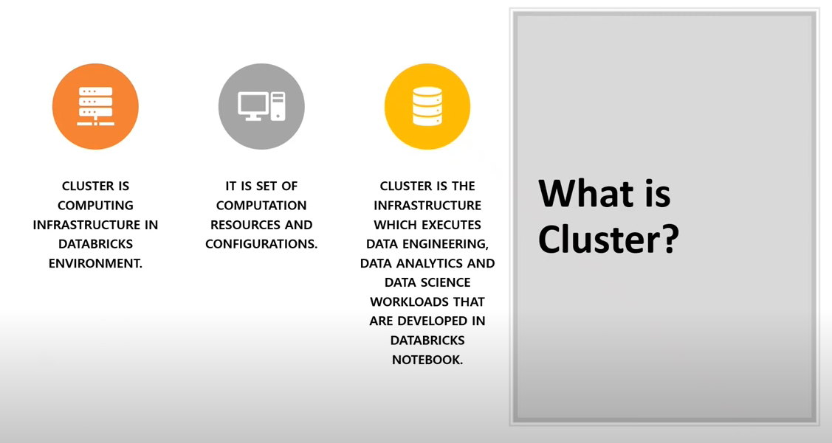
Introduction to Cluster
Deloitte Touche Tohmatsu India LLP
Big Data Playbook

Slide 21
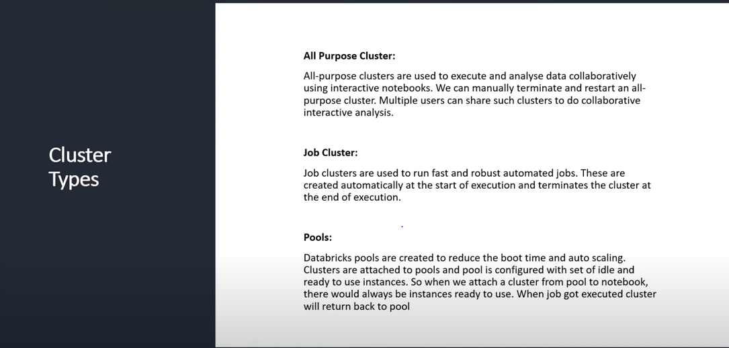
Types of Cluster
Deloitte Touche Tohmatsu India LLP
Big Data Playbook

Slide 22
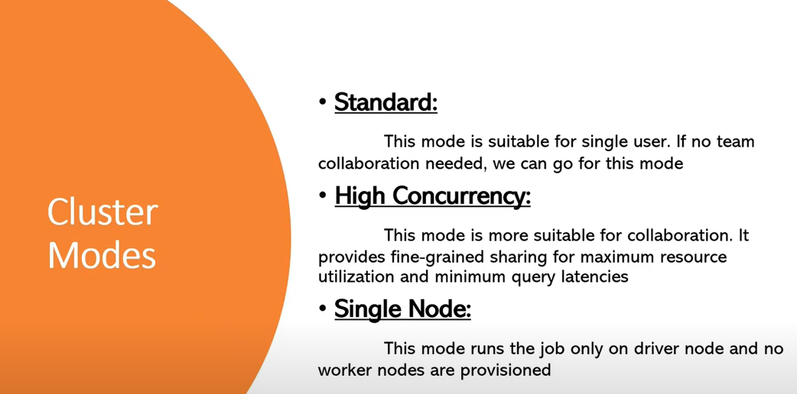
Modes of Cluster
Deloitte Touche Tohmatsu India LLP
Big Data Playbook

Slide 23
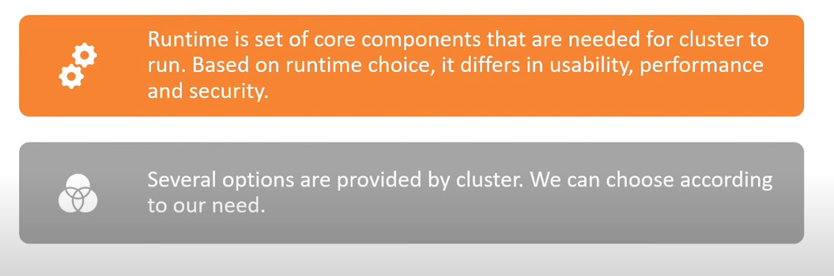
Cluster Run-Time
Deloitte Touche Tohmatsu India LLP
Big Data Playbook

Slide 24
Spark SQL

Slide 25
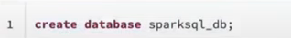
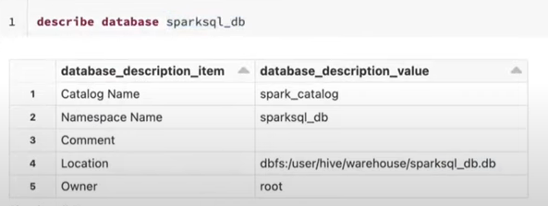
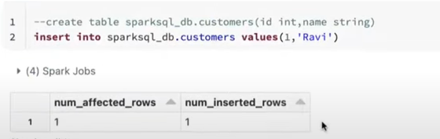
Creation of Database
Deloitte Touche Tohmatsu India LLP
Big Data Playbook

Slide 26
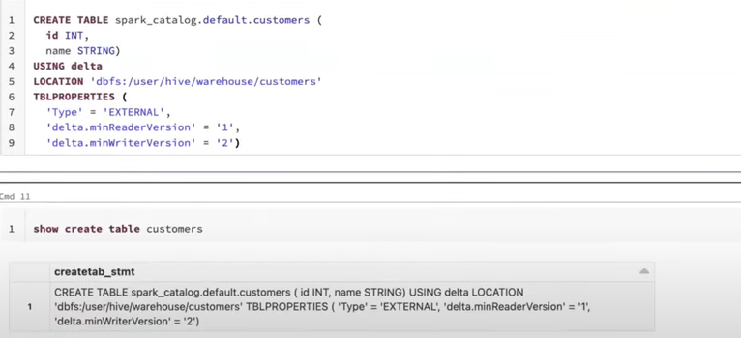
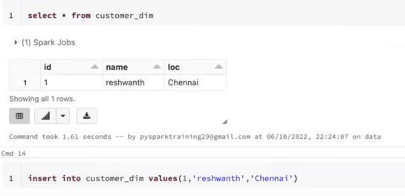
Creation of Table
Deloitte Touche Tohmatsu India LLP
Big Data Playbook

Slide 27
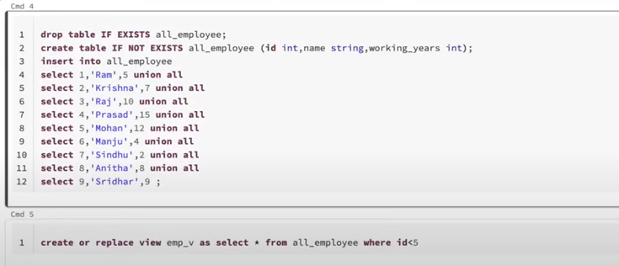
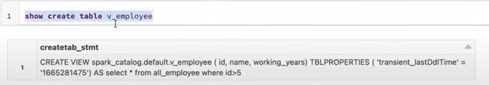
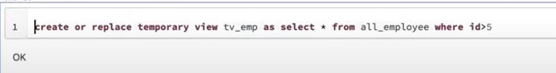
Creation of View
Deloitte Touche Tohmatsu India LLP
Big Data Playbook

Slide 28
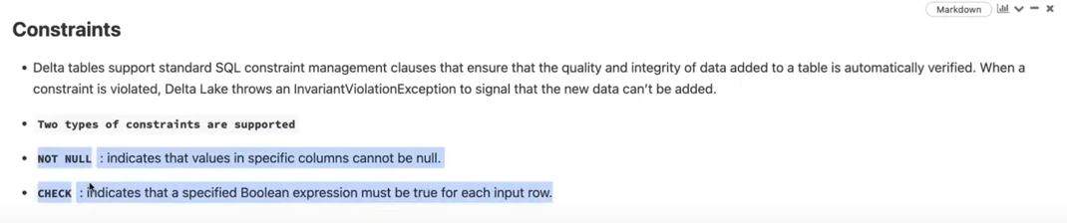
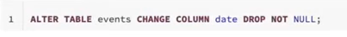
Constraints
Deloitte Touche Tohmatsu India LLP
Big Data Playbook

Slide 29
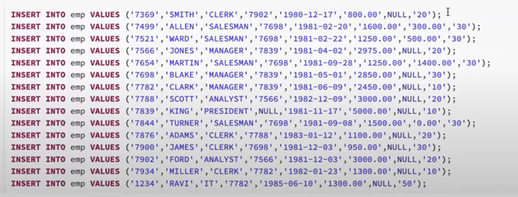
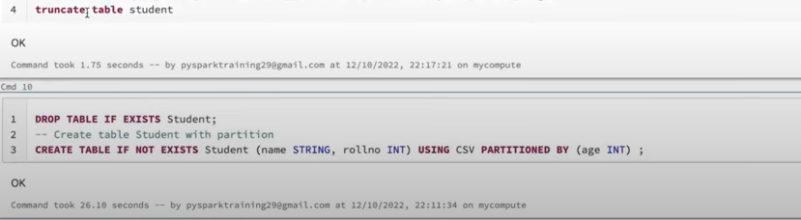
Spark SQL Insert Functions (DML)
Deloitte Touche Tohmatsu India LLP
Big Data Playbook

Slide 30
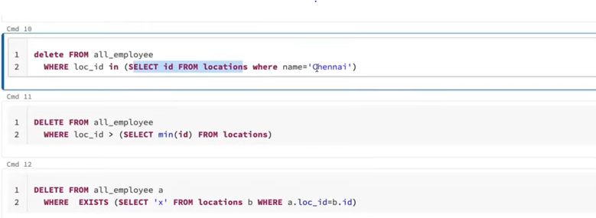
Spark SQL Delete Functions (DML)
Deloitte Touche Tohmatsu India LLP
Big Data Playbook

Slide 31
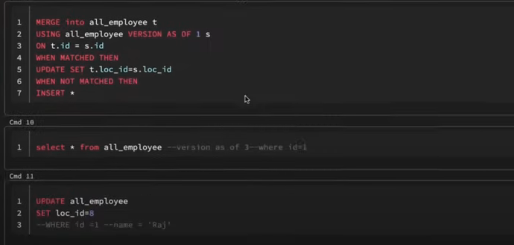
Spark SQL Update and Merge (DML)
Deloitte Touche Tohmatsu India LLP
Big Data Playbook

Slide 32
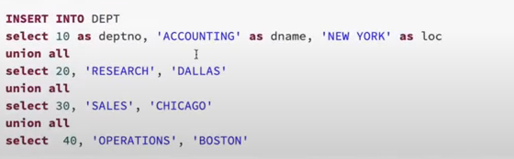
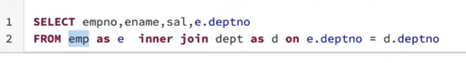
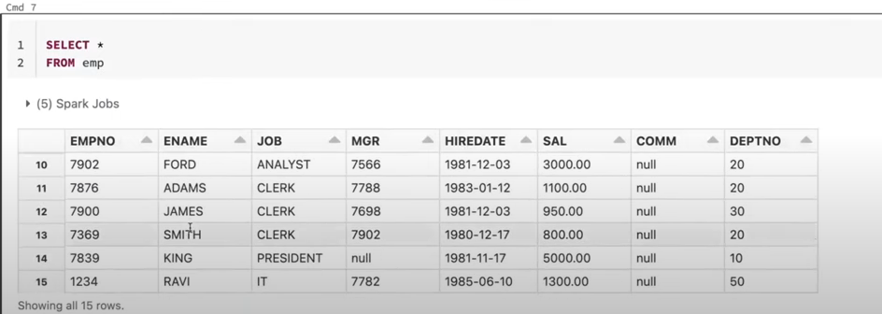
Spark SQL Select (DRL)
Deloitte Touche Tohmatsu India LLP
Big Data Playbook

Slide 33
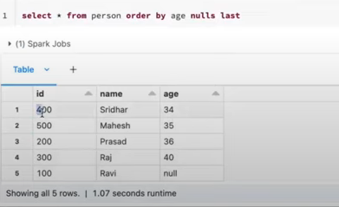
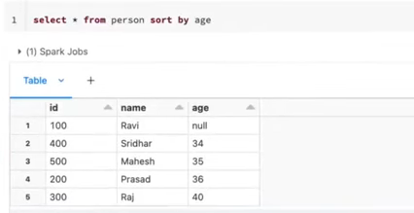
Spark SQL Order By & Sort By (DRL)
Deloitte Touche Tohmatsu India LLP
Big Data Playbook

Slide 34
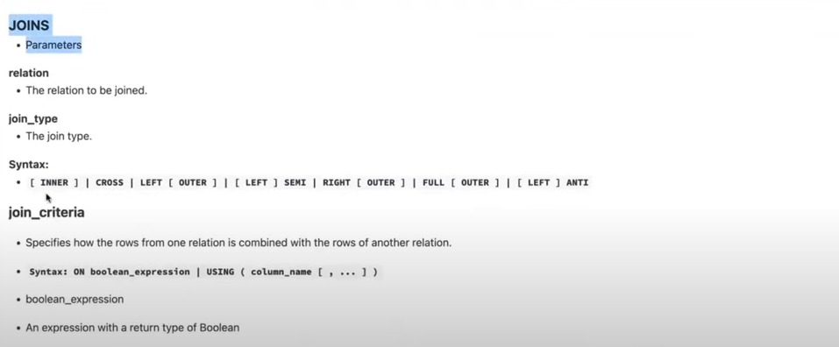
Spark SQL Joins (DRL)
Deloitte Touche Tohmatsu India LLP
Big Data Playbook

Slide 35
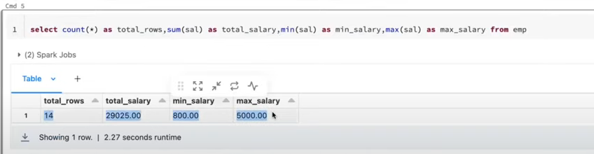
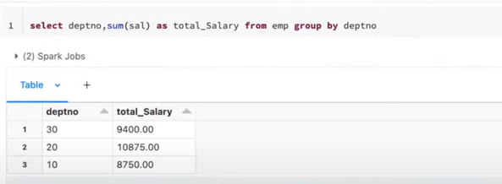
Spark SQL Aggregation Functions and Group BY
Deloitte Touche Tohmatsu India LLP
Big Data Playbook

Slide 36
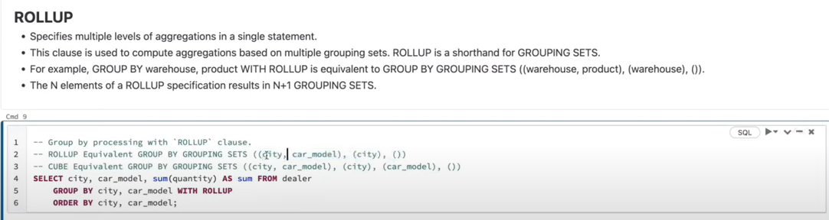
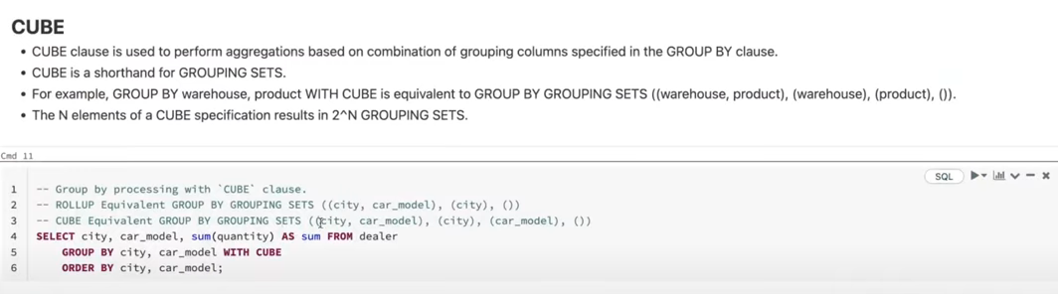
Spark SQL Group BY
Deloitte Touche Tohmatsu India LLP
Big Data Playbook

Slide 37
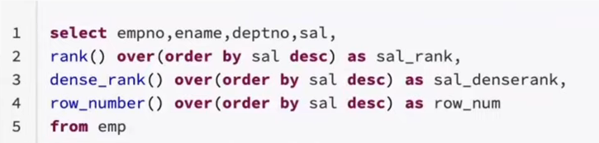
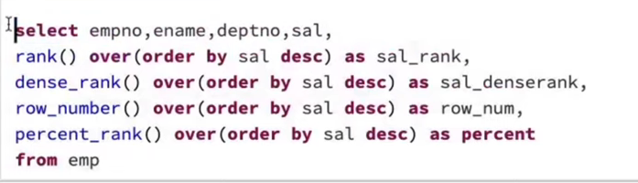
Spark SQL window ranking functions
Deloitte Touche Tohmatsu India LLP
Big Data Playbook

Slide 38
PySpark

Slide 39
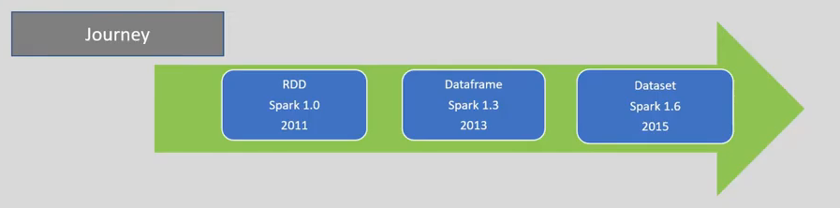
Introduction to PySpark (1/2)
To support Python with Spark, Apache Spark Community released a tool, PySpark. Using PySpark, you can work with RDDs in Python programming language also. It is because of a library called Py4j that they can achieve this.
PySpark offers PySpark Shell which links the Python API to the spark core and initializes the Spark context. Majority of data scientists and analytics experts today use Python because of its rich library set. Integrating Python with Spark is a boon to them.
Dataset = Best of RDD + Best of Dataframe
Best of RDD:
Programming Control OOPs
Type Safety
Best of Dataframe:
Relational Format
Optimization
Memory Management
Deloitte Touche Tohmatsu India LLP
Big Data Playbook

Slide 40
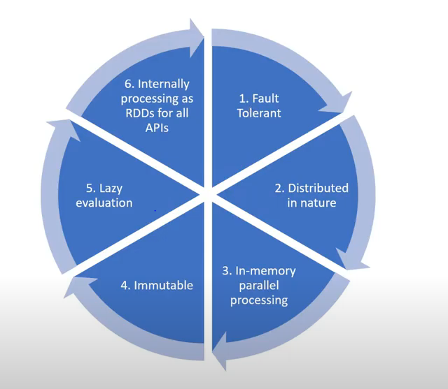
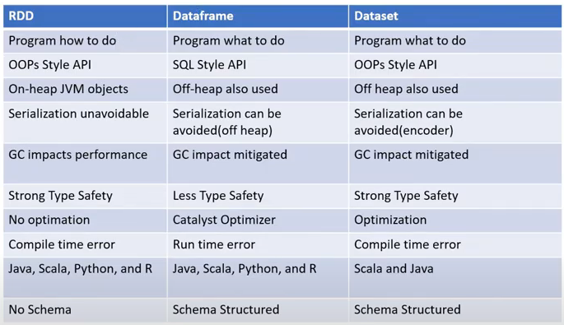
Introduction to PySpark (2/2)
Similarities
Differences
Deloitte Touche Tohmatsu India LLP
Big Data Playbook

Slide 41
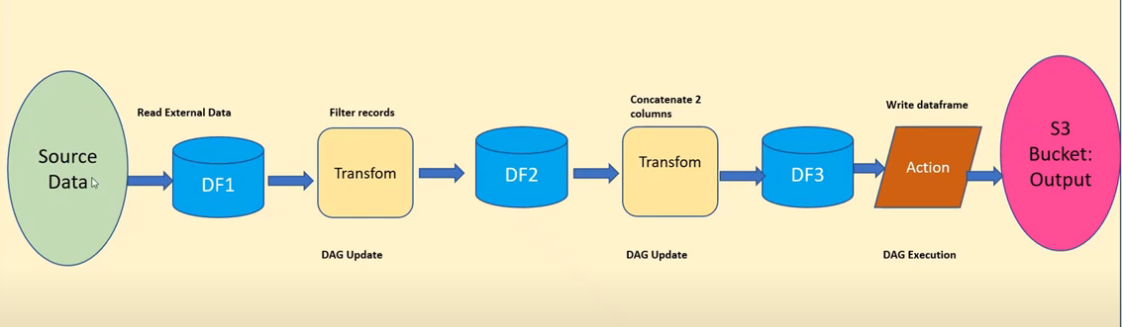
Transformation & Action
Transformation:
Transformation is a kind of operation which will transform Dataframe from one form to another. We will get new Dataframe after execution of each transformation operation. Transformation is lazy evaluation based on DAG (Directed Acyclic Graph). Filter, Union etc.,
Action:
When we want to work with actual data, call the action. Action returns the data to driver for display or storage into storage layer. Count, collect, save etc.
Deloitte Touche Tohmatsu India LLP
Big Data Playbook

Slide 42
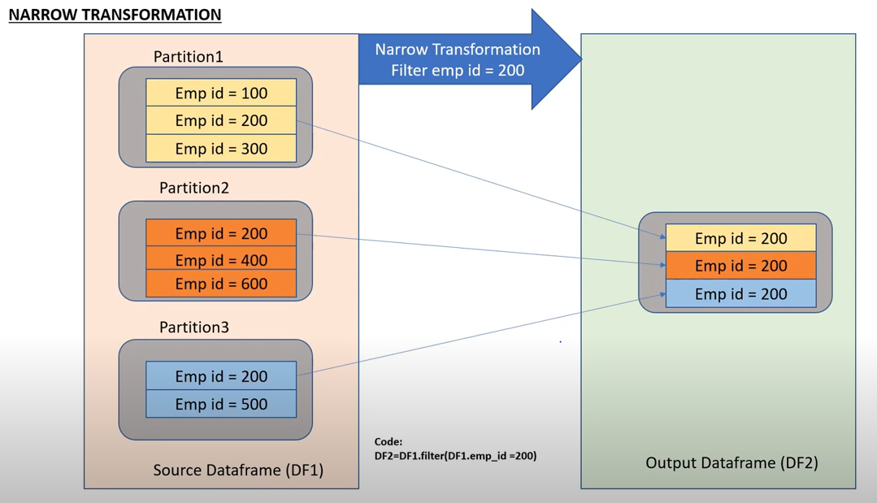
Narrow Transformation
Deloitte Touche Tohmatsu India LLP
Big Data Playbook

Slide 43
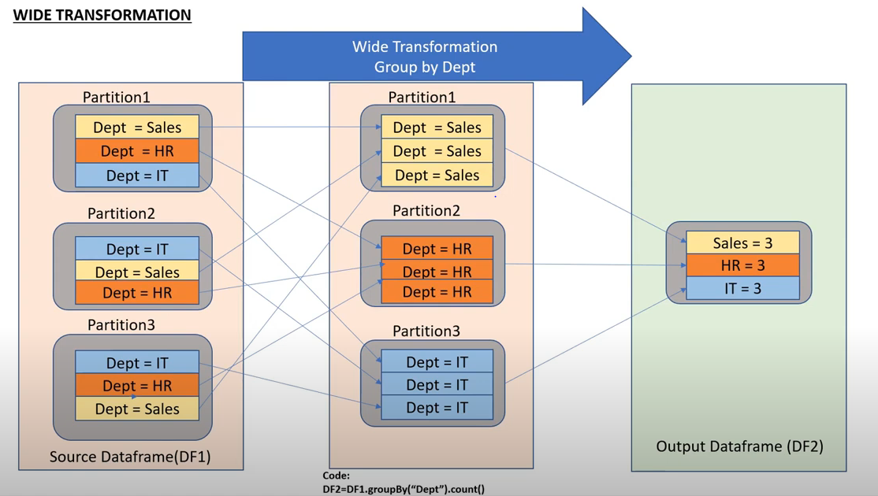
Wide Transformation
Deloitte Touche Tohmatsu India LLP
Big Data Playbook

Slide 44
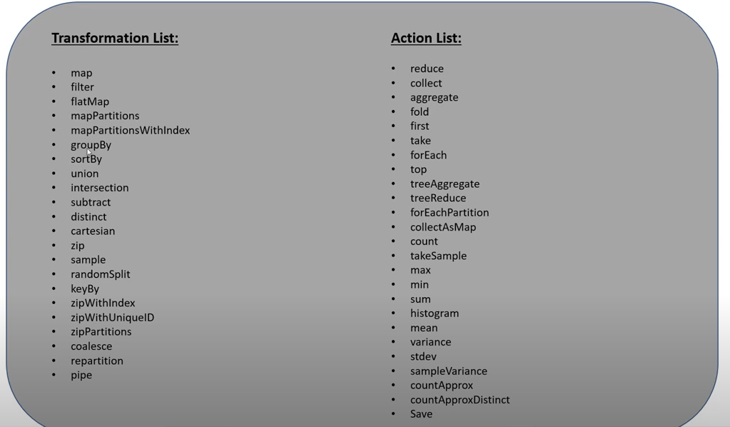
Common Transformations & Actions
Deloitte Touche Tohmatsu India LLP
Big Data Playbook

Slide 45
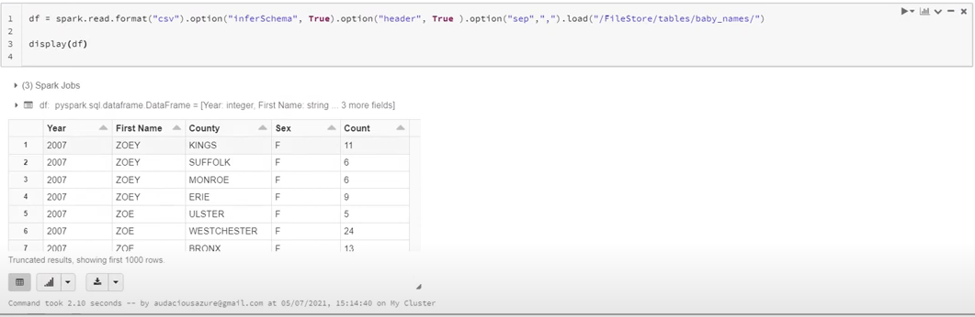
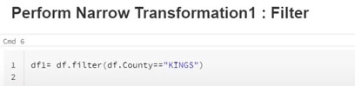



Examples of Transformations and Actions
Deloitte Touche Tohmatsu India LLP
Big Data Playbook

Slide 46

Reading Files (CSV)
Deloitte Touche Tohmatsu India LLP
Big Data Playbook

Slide 47

Filter Function
Deloitte Touche Tohmatsu India LLP
Big Data Playbook

Slide 48

Add, Rename and Drop Functions
Deloitte Touche Tohmatsu India LLP
Big Data Playbook

Slide 49

Join Conditions
Deloitte Touche Tohmatsu India LLP
Big Data Playbook

Slide 50

DBUtils Commands (1/3)
Deloitte Touche Tohmatsu India LLP
Big Data Playbook

Slide 51

DBUtils Commands (2/3)
Deloitte Touche Tohmatsu India LLP
Big Data Playbook

Slide 52

DBUtils Commands (3/3)
Deloitte Touche Tohmatsu India LLP
Big Data Playbook

Slide 53

Explode Function (1/2)
Deloitte Touche Tohmatsu India LLP
Big Data Playbook

Slide 54

Explode Function (2/2)
Deloitte Touche Tohmatsu India LLP
Big Data Playbook

Slide 55

CASE Functions (1/2)
Deloitte Touche Tohmatsu India LLP
Big Data Playbook

Slide 56

CASE Functions (2/2)
Deloitte Touche Tohmatsu India LLP
Big Data Playbook

Slide 57

Union & UnionAll Functions (1/3)
Deloitte Touche Tohmatsu India LLP
Big Data Playbook

Slide 58

Union & UnionAll Functions (2/3)
Deloitte Touche Tohmatsu India LLP
Big Data Playbook

Slide 59

Union & UnionAll Functions (3/3)
Deloitte Touche Tohmatsu India LLP
Big Data Playbook

Slide 60

Pivot and Unpivot Functions (1/2)
Deloitte Touche Tohmatsu India LLP
Big Data Playbook

Slide 61

Pivot and Unpivot Functions (2/2)
Deloitte Touche Tohmatsu India LLP
Big Data Playbook

Slide 62

Read Json Files
Deloitte Touche Tohmatsu India LLP
Big Data Playbook

Slide 63

Flatten Json Files
Deloitte Touche Tohmatsu India LLP
Big Data Playbook

Slide 64

Corrupt Record Handling (1/2)
Deloitte Touche Tohmatsu India LLP
Big Data Playbook

Slide 65

Corrupt Record Handling (2/2)
Deloitte Touche Tohmatsu India LLP
Big Data Playbook

Slide 66

Streaming Terminologies
Deloitte Touche Tohmatsu India LLP
Big Data Playbook

Slide 67




Performance Optimization (1/5)
Adopting best partition strategy is designing best performance in spark application.
The right number of partitions created based on number of cores boosts the performance. If not, hits the performance.
Evenly distributed partition improves the performance, unevenly distributed partitions hit the performance.
Let’s say only one partition is created with size of 500 MB in a worker node with 16 cores. One partition can’t be shared among cores. So, one core would be processing 500 MB data where 15 cores are kept idle.
Deloitte Touche Tohmatsu India LLP
Big Data Playbook

Slide 68

Performance Optimization - Repartition (2/5)
Deloitte Touche Tohmatsu India LLP
Big Data Playbook

Slide 69

Performance Optimization – Repartition (3/5)
Deloitte Touche Tohmatsu India LLP
Big Data Playbook

Slide 70

Performance Optimization – Coalesce (4/5)
Deloitte Touche Tohmatsu India LLP
Big Data Playbook

Slide 71

Performance Optimization – Coalesce (5/5)
Deloitte Touche Tohmatsu India LLP
Big Data Playbook

Slide 72

Broadcast Variable (Optimized Join) (1/4)
Deloitte Touche Tohmatsu India LLP
Big Data Playbook

Slide 73

Broadcast Variable (Optimized Join) (2/4)
Deloitte Touche Tohmatsu India LLP
Big Data Playbook

Slide 74

Broadcast Variable (Optimized Join) (3/4)
Deloitte Touche Tohmatsu India LLP
Big Data Playbook

Slide 75

Broadcast Variable (Optimized Join) (4/4)
Deloitte Touche Tohmatsu India LLP
Big Data Playbook

Slide 76


Handling Null - (1/3)
The function isNull() returns all the rows where certain column on which we apply this function contains Null Values
The function isNotNull() creates new dataframe by eliminating all the rows where certain column on which we apply this function contains Null Values
Deloitte Touche Tohmatsu India LLP
Big Data Playbook

Slide 77

Handling Null - (2/3)
na.drop() drops the rows if any or all columns contain null values
Deloitte Touche Tohmatsu India LLP
Big Data Playbook

Slide 78

Handling Null - (3/3)
na.fill() populates dummy value of all null values given as parameter to this function
Deloitte Touche Tohmatsu India LLP
Big Data Playbook

Slide 79


Split Function (Pyspark SQL Function)
Pyspark function that splits a single column into multiple columns based on certain logic.
Str – a string expression to split
Pattern – a string representing a regular expression
Limit – optional; an integer that controls the number of times the pattern in used.
Deloitte Touche Tohmatsu India LLP
Big Data Playbook

Slide 80

Arrays
Deloitte Touche Tohmatsu India LLP
Big Data Playbook

Slide 81

Arrays – arrays_zip
Deloitte Touche Tohmatsu India LLP
Big Data Playbook

Slide 82

Arrays (arrays_zip)
Deloitte Touche Tohmatsu India LLP
Big Data Playbook

Slide 83

Arrays (array_intersect)
Pyspark function that returns common elements across two arrays without any duplication.
Deloitte Touche Tohmatsu India LLP
Big Data Playbook

Slide 84
Partition By
Function used to write the dataframe into disc partitioned by specific key(s).
Deloitte Touche Tohmatsu India LLP
Big Data Playbook

Slide 85
Delta Lake (High Level Intro)

Slide 86

Introduction to Delta Lake
Deloitte Touche Tohmatsu India LLP
Big Data Playbook

Slide 87

Introduction to Delta Lake
Data Warehouse
Data Lake
Delta Lake
Deloitte Touche Tohmatsu India LLP
Big Data Playbook

Slide 88

Introduction to Delta Lake
Deloitte Touche Tohmatsu India LLP
Big Data Playbook

Slide 89

Delta Lake Architecture
Deloitte Touche Tohmatsu India LLP
Big Data Playbook

Slide 90


Create Delta Tables (using Pyspark and Spark SQL)
Deloitte Touche Tohmatsu India LLP
Big Data Playbook

Slide 91
Delta Lake – Practical Demo

Slide 92
Thank You

